Slide 1
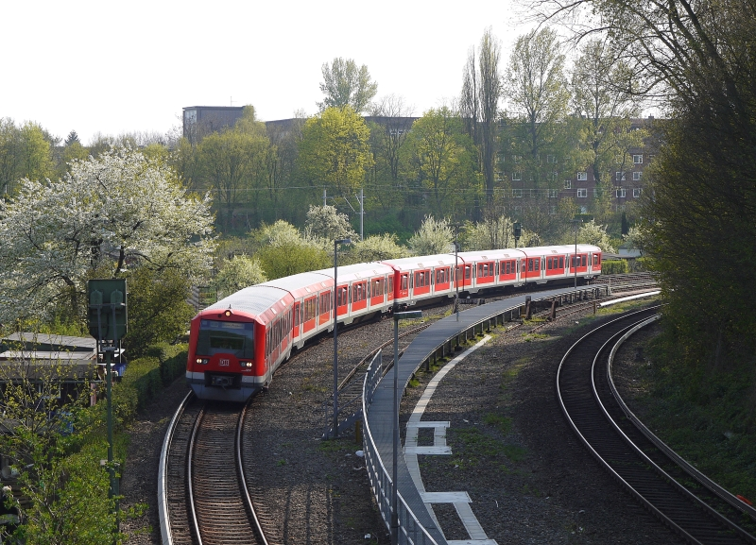
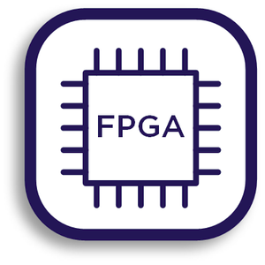
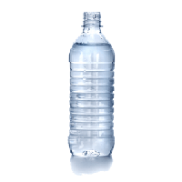


Audio Processing with a FPGA
using Neural Networks
The idea :
If the train screeches in the curve use a liquid to reduce to noise
The proposed solution:
Use a FPGA to determine whether the screech noise starts to occur.

Slide 2
The key parts of the project
Implementing the Neural Network in VHDL
Augmenting the Audio Data.. ‘cause there is not enough
Choose the right Neural Network architecture and train it
Process the Audio Data and build the signal pipeline

Slide 3
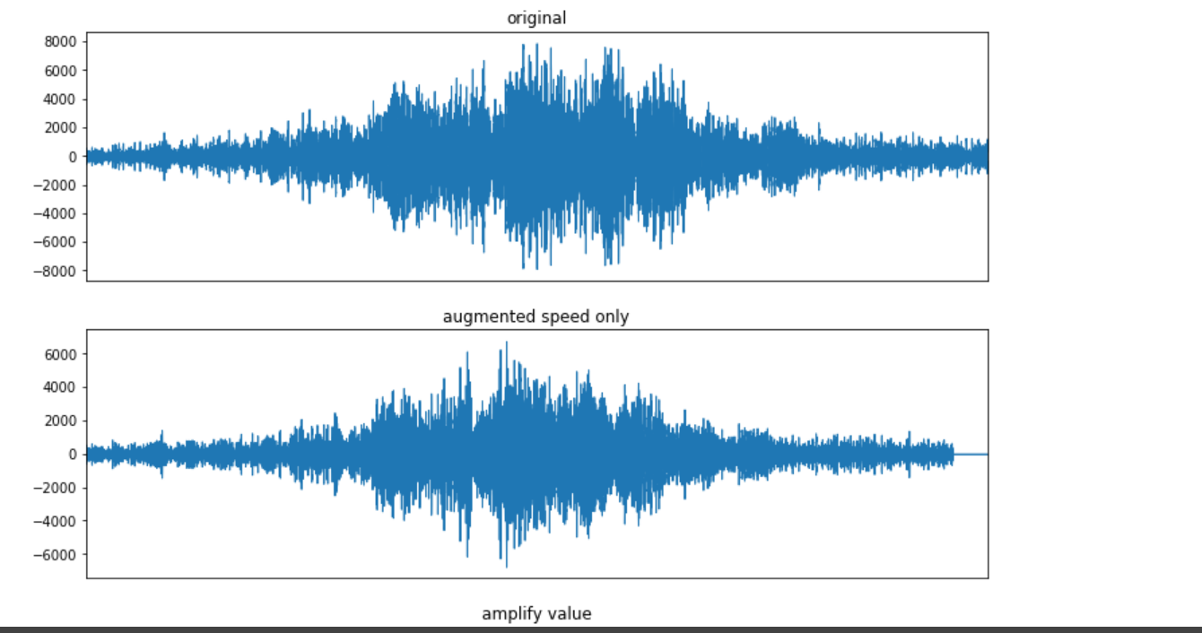
Audio Data Augmentation
Task: How to change the Audio Signal while still keeping a similar noise?

Slide 4
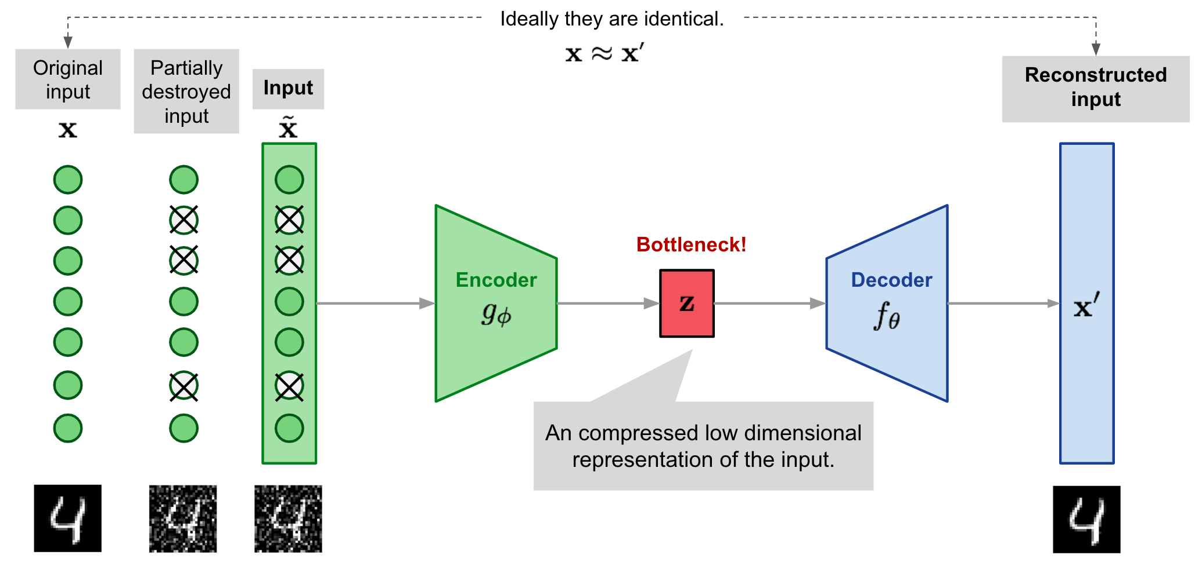
Denoising Autoencoder
Use the Autoencoder as a filter. Find the weights to be able to reconstruct the creech signal, filtering out noise.

Slide 5
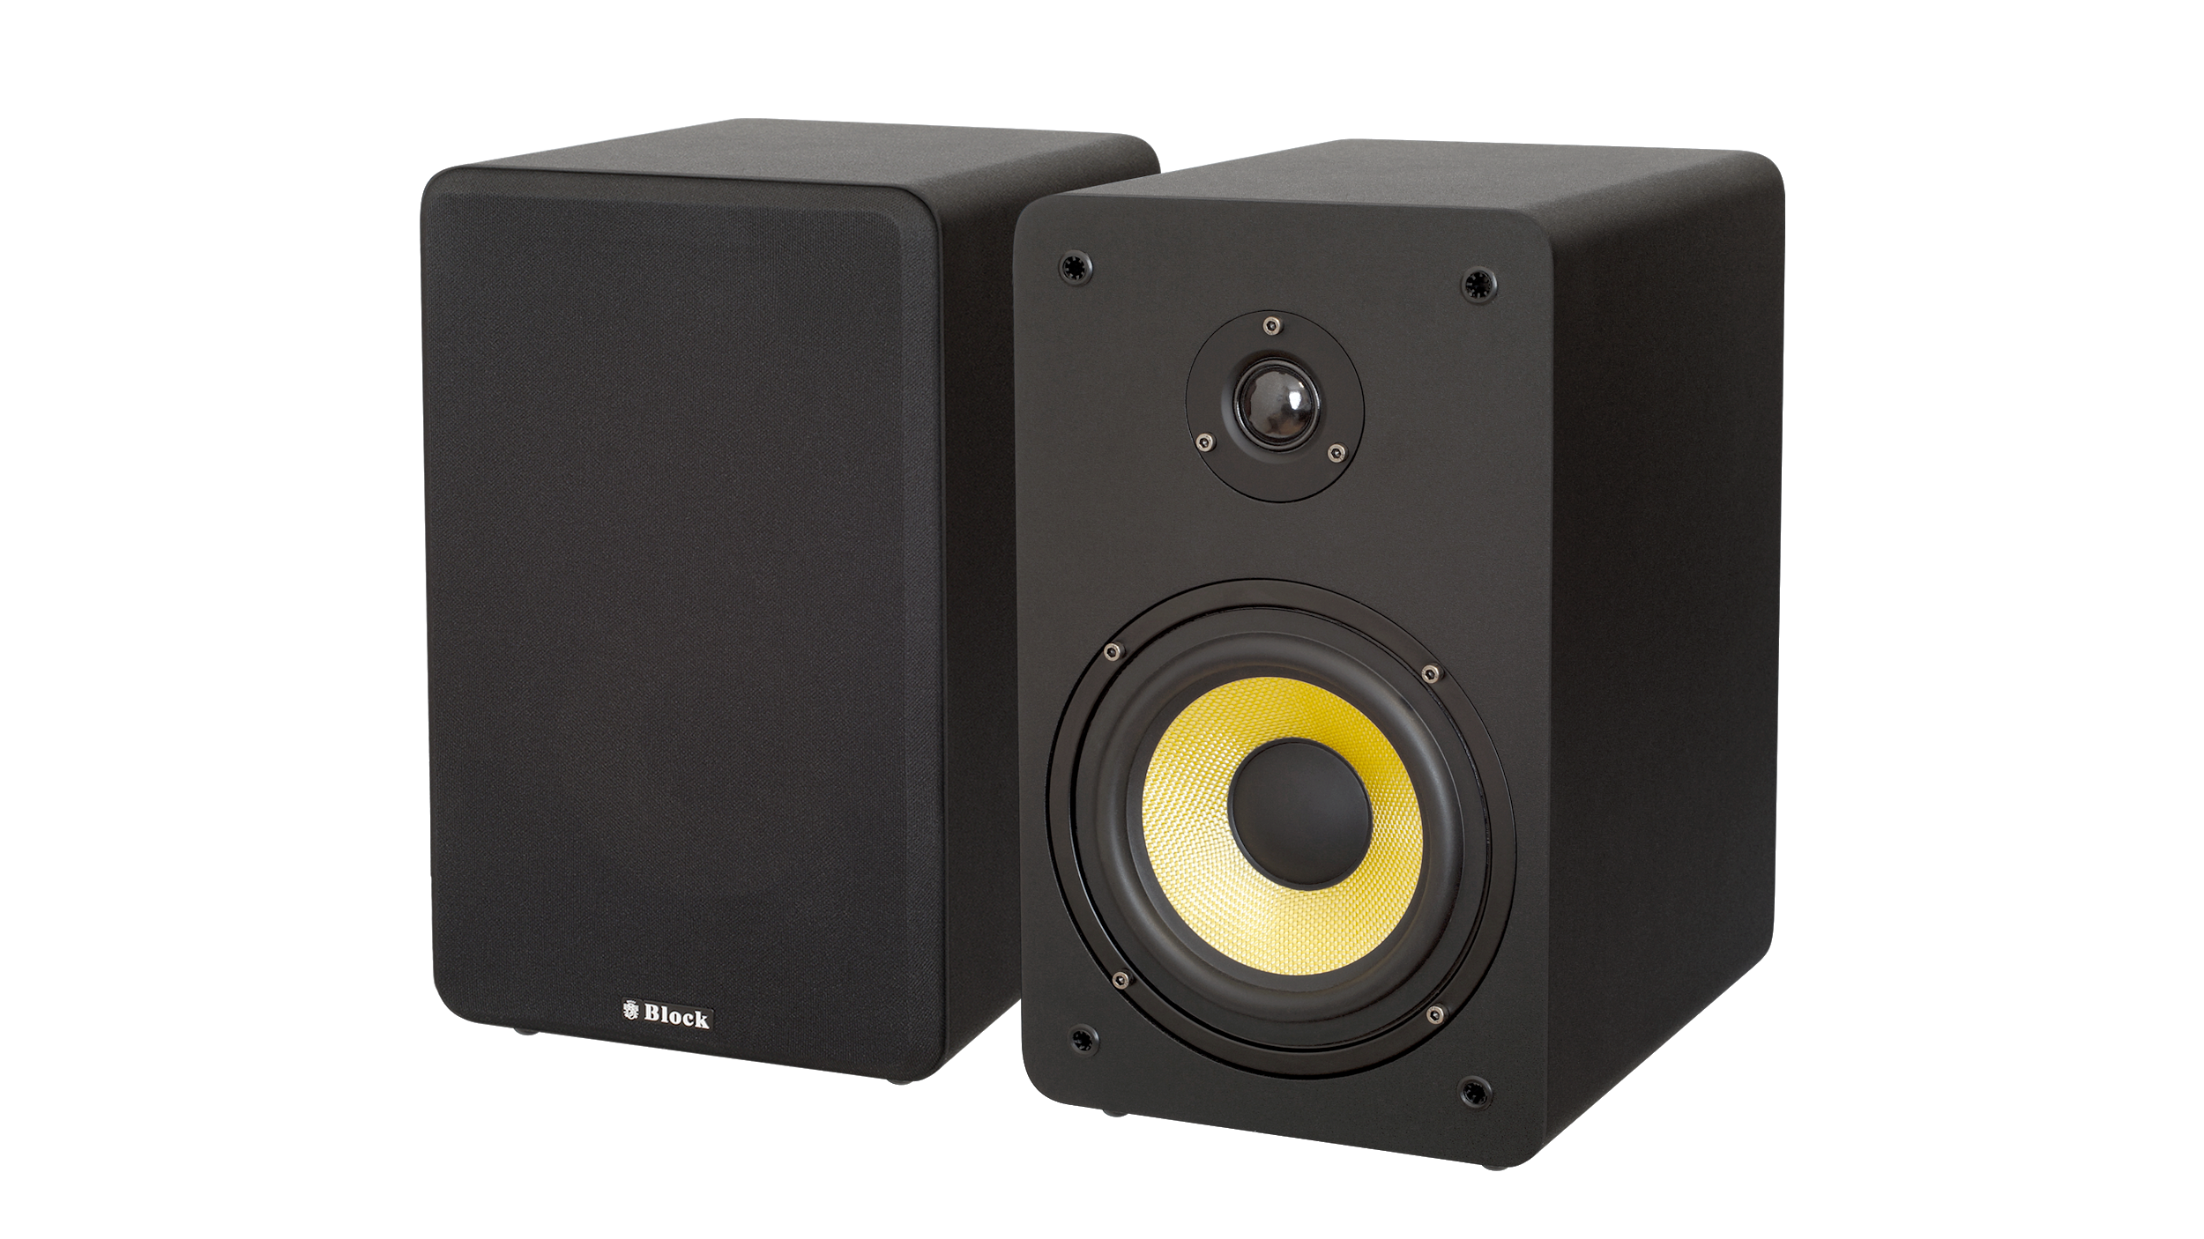
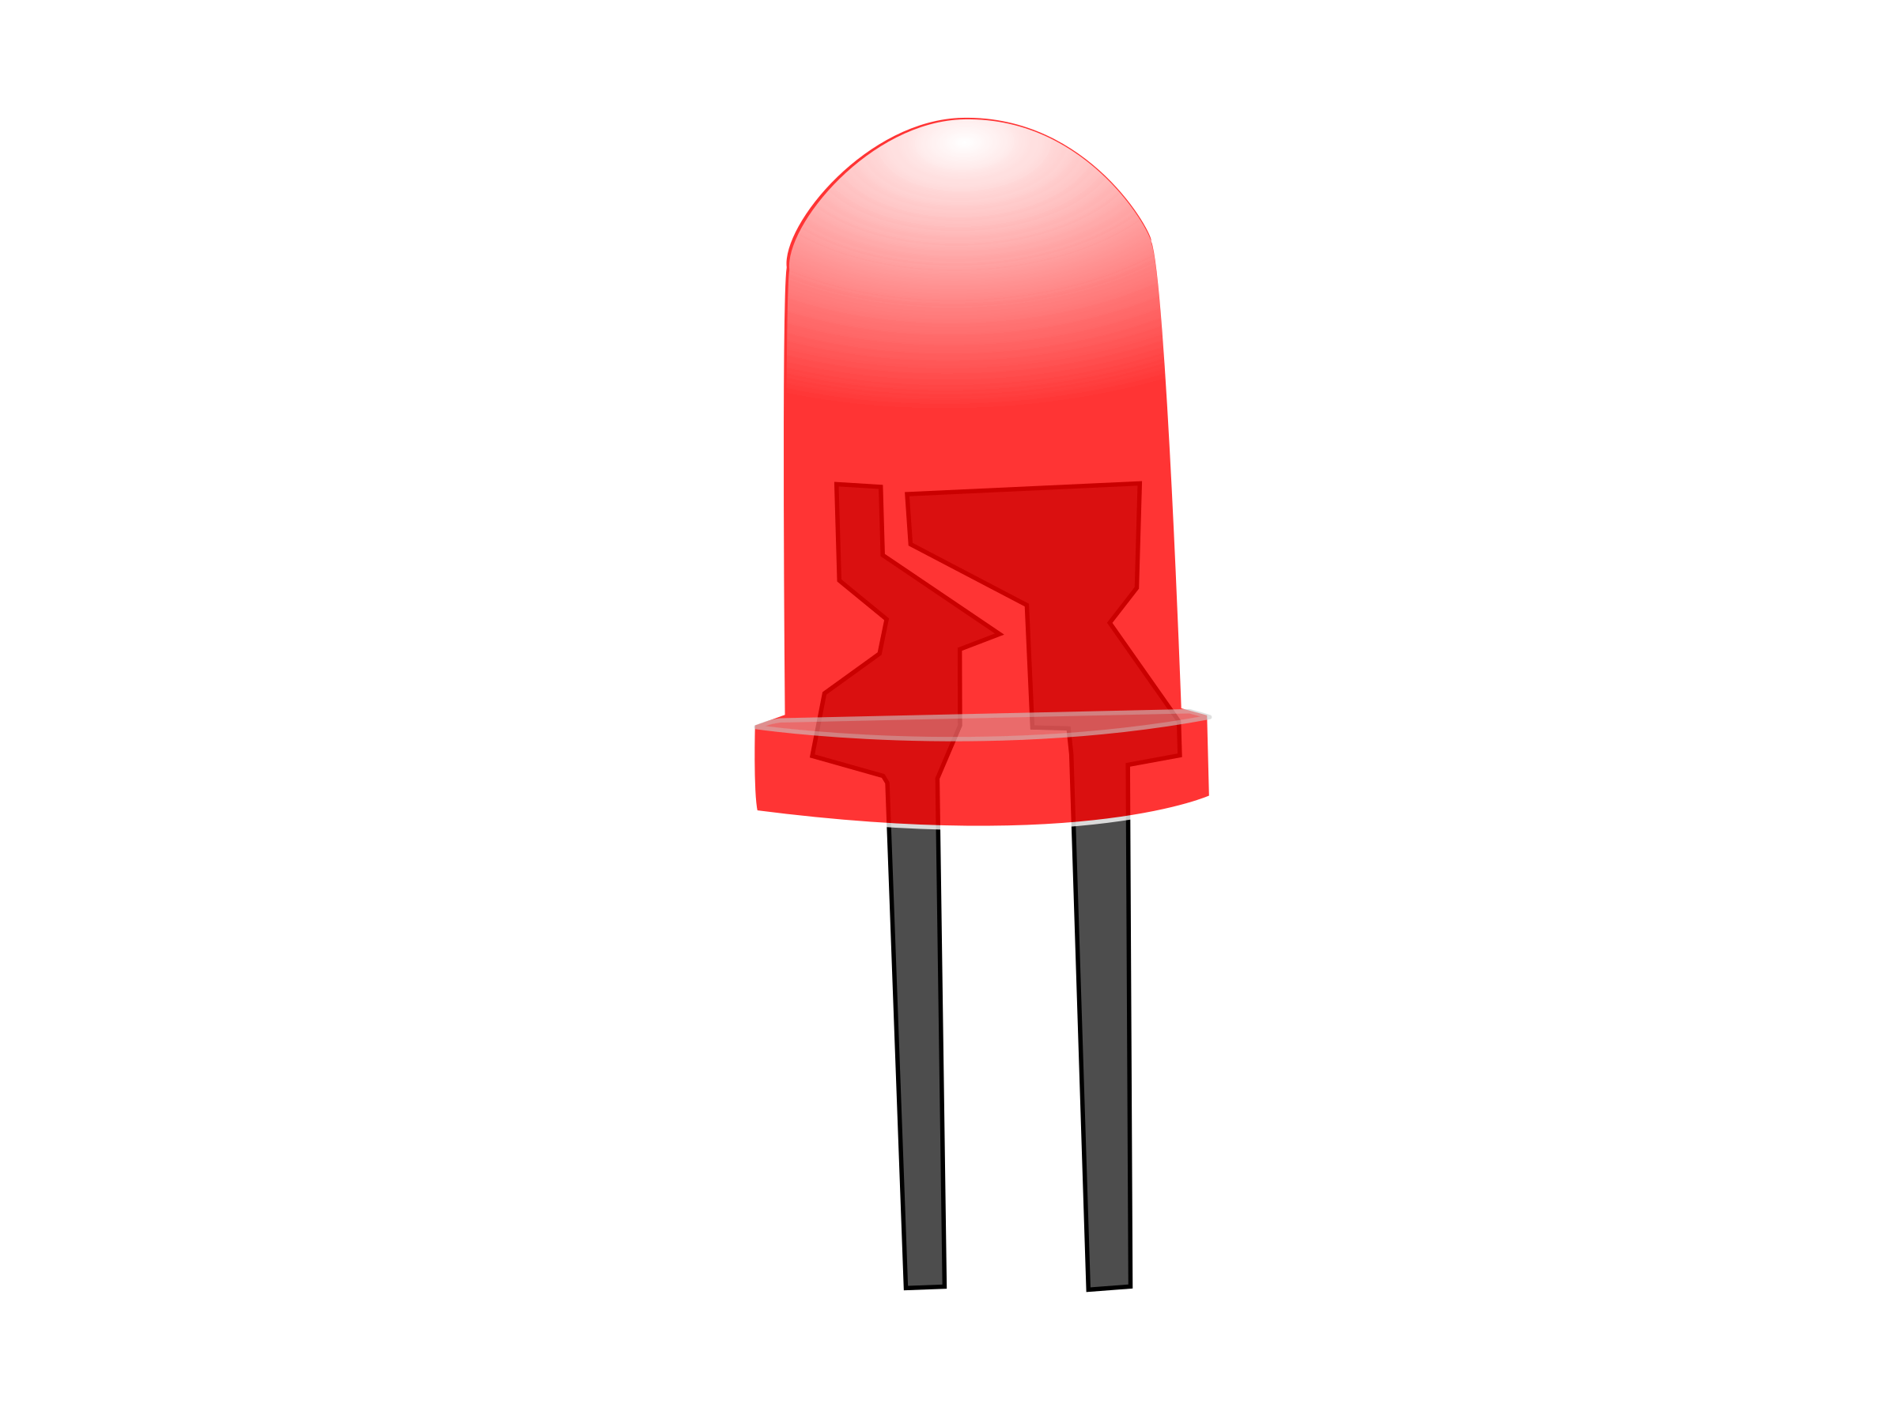
The pipeline
Sliding window possible
Altera DE2: CYCLONE IV FPGA
INPUT
FIFO Buffer
Ring Buffer
Bigger input vector
Audio CoDec
Wolfson
WM 8371
Filter:
Denoising Autoencoder
OUTPUT
FIFO Buffer
Compare Unit:
Distance Function
Screech Signal or not ?
The pipeline to process audio data and detect similarities.

